Slide 1
Meet the teacher
RaINBOW Class
2026-2027

Slide 2
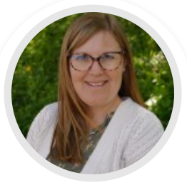
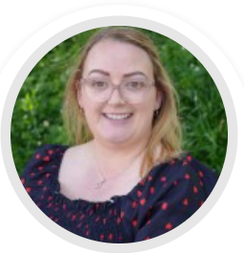
The class team
Teacher: Mrs Bailey
Teaching Assistant: Mrs Whyman
Welcome to Rainbow Class! We are excited to get started.

Slide 3
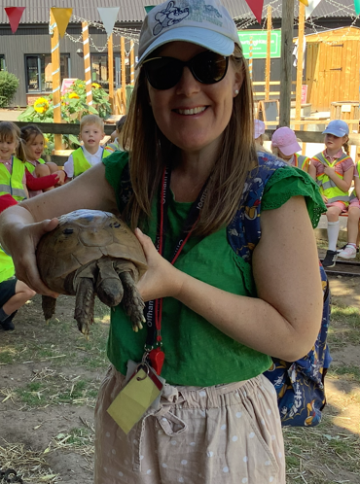
ABOUT MRS BAILEY
Graduated with BA in Primary Teacher Education in 2009.
I have taught all year groups in my career however vast majority of my career has been spent in EYFS and KS1.
Passionate and caring teacher.
I have three children – who are 11, 9 and 5.
Enjoy spending time outdoors, visiting new places and all things Disney!

Slide 4

How to communicate with us
You are welcome to talk to us at any time.
If you’d like to talk to us at length regarding anything, please book an appointment through the office or contact us via class dojo.
Please contact the office via email or phone if a different adult is picking up your child. We will not release children unless we know in advance who they are meant to be going home with.

Slide 5
Ways the school will communicate with you
Please can we take the opportunity to remind you that the school will officially share information with you about upcoming activities and events in the following ways:
* Via the school calendar - this includes information about all currently planned activities between now and Christmas. The calendar can be located on the school website.
* Via the weekly newsletter. This is currently uploaded onto the school website and dojo. Upcoming dates, information about upcoming activities and celebrations of children's work are all included in this newsletter. The newsletter is sent out on a Friday afternoon.
* Via a direct email to your inbox. These will come through titled office@offham- please make sure that this address is not being filtered to your spam
* Via the class pages on the school website. Here you will find a termly newsletter detailing information about your child's learning and giving more specific information directly from the teacher about things the children may need this term.
* Via class dojo. Updates, upcoming trips, homework and general notices from your class teacher will appear here.

Slide 6
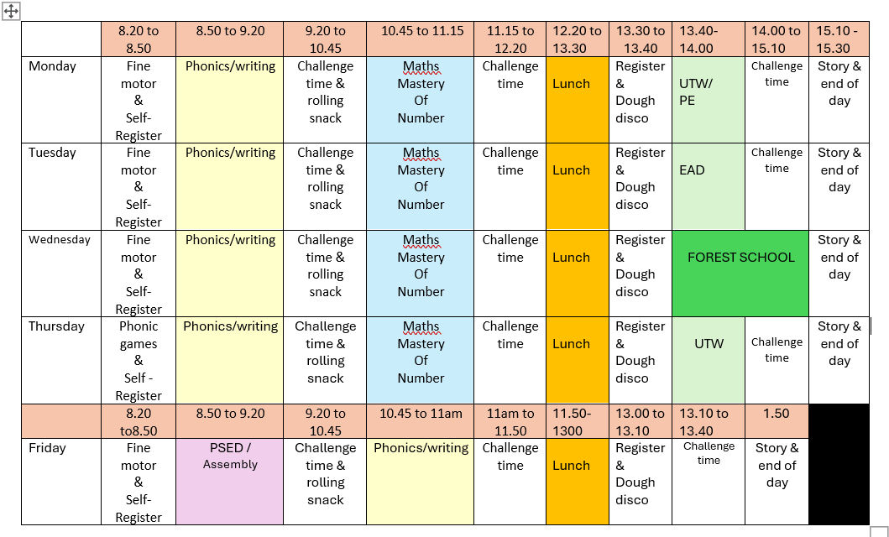
Class timetable

Slide 7


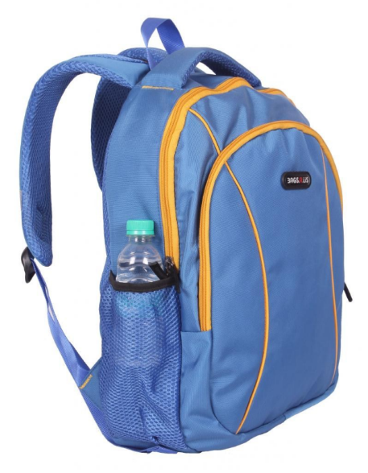

What does my child need in school?
Children should have a water bottle (named) in school every day.
School bags should be named and placed on pegs.
Wellington boots should be left in school for us to access daily.
Reading books from school (or home) should be brought in daily.

Slide 8

SCHOOL UNIFORM
Please can I remind you all that it is important that all children are dressed according to the school uniform policy.
Offham colours are red, white and grey. Children require:
red sweatshirts or cardigans (School logo or no logo)
grey trousers, shorts, skirts or pinafore dresses
checked red and white summer dresses
white polo shirts, shirts or blouses (School logo or no logo)
white or grey socks
grey tights
sensible black school shoes/boots - no open toes or heels
We ask that all hair, below chin length, is tied back sensibly with small hair bobbles and bows (this includes long hair on boys). Earrings should be small studs but should be removed for P.E. lessons. If this is not possible, please supply your child with medical tape to cover their earrings.

Slide 9
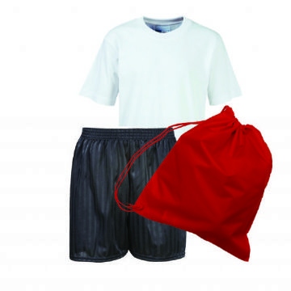
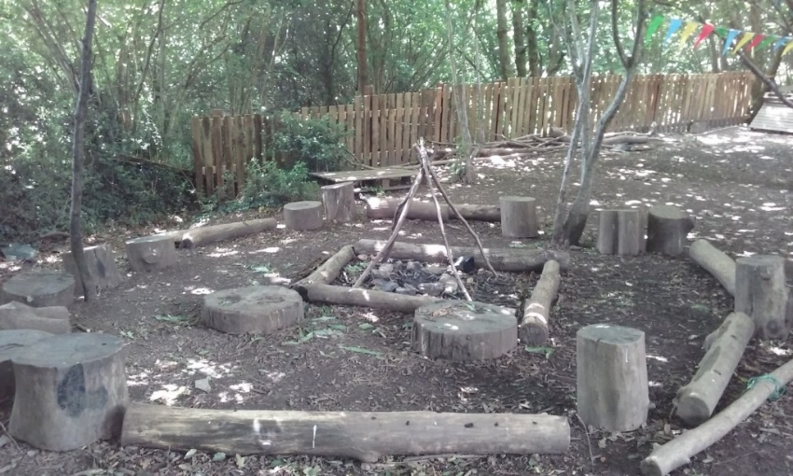
PE/FOREST SCHOOL UNIFORM
Children should wear PE kits on PE days as specified by the class teacher.
P.E t-shirt in the house colour (School logo or no logo)
Red hoodie (School logo or no logo)
P.E shorts black (to the knee)
Black leggings or black joggers
P.E socks – white
Outdoor black trainers
Children should wear PE kits on forest school days as specified by the class teacher.
Wellington boots for Forest School wet weather
Waterproof clothing for Forest School wet weather

Slide 10

Examples of Topics WE COVER:
For further information regarding this year's curriculum and a full overview, please see the school website.

Slide 11
HOME LEARNING
Daily reading of school reading book.
Practise learnt sounds and harder to read and spell words e.g. the was put
Family games including board games, card games, I spy, scavenger hunts etc.
Class bear – comes home Friday, due back following Wednesday (latest).

Slide 12


Strategies and rewards
Golden balls
Dojos
Certificate of Achievement
House parties
Celebration of work with Headteacher

Slide 13

Friday celebration assembly
Friday celebration assemblies will still be held on a Friday morning but this year – you’re invited!
If your child has received a certificate, you will be notified a week prior and have the opportunity to come in and see your child obtain their certificate in assembly!

Slide 14
Dates for parents evening
Tuesday 20th October – 3.45 – 6.30 pm
Thursday 22nd October – 3.45 – 6.30 pm

Slide 15
What’s coming up?
Village walk day – 16th October
Discovery Den opening/Party in the Park – 18th September
Open mornings for current parents – 29th September and 1st October 9.30 am, 11.00 am and 2.00 pm.
School Disco – 1st October
Inset day – 23rd October

